Slide 1



OCCUPATIONAL STRESS
Week 13
Notes:
Designed and created by Dandi Yang. Do not duplicate or upload with the express written permission of the author.

Slide 2
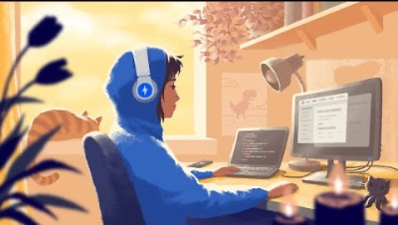
Notes:
Before we begin, please feel free to open up this video, keep in the background and and enjoy some chill, lo-fi beats as you navigate through this lecture. Or watch the video in between work sessions to destress and refocus.
https://www.youtube.com/watch?v=f02mOEt11OQ

Slide 3




OVERVIEW
Definition and Contexts
Occupational Stressors
The Workaholic
Burnout
Working From Home
Interventions

Slide 4


Definition:
Occupational stress is the combination of sources of stress at work, individual characteristics, and extra-organizational stressors
OCCUPATIONAL
STRESS
Notes:
Occupational stress is the combination of sources of stress at work, individual characteristics and extra-organizational stressors.
It is a complex phenomenon that impacts everyone differently, based on the workplaces they find themselves in, their own individual characteristics, and the stressors that exist outside their workplace (extra-organizational stressors).
Occupational stress and stressful working conditions have been linked to low productivity, absenteeism, and increased rates of accidents on and off the job.

Slide 5




WHY IS IT A CONCERN?
Cost to businesses is billions of dollars per year
Leads to increased sick days, drug or alcohol abuse, and early death
Source of unhappiness for individuals
Can promote high turnover rates of employees
Technological advances keep employees tethered to work

Slide 6
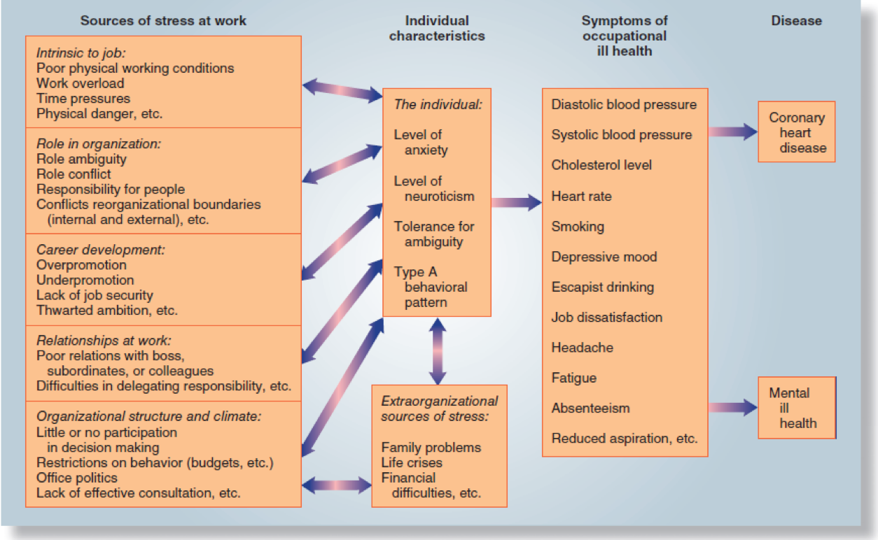
OCCUPATIONAL HEALTH MODEL
Notes:
Stress at work: relationships are work, career development, organizational structure
Extra-organizational stressors (home-life): family problems, financial difficulties, life crises
Individual characteristics: level of anxiety, neuroticism.

Slide 7

CONSTRUCTS OF OCCUPATIONAL STRESS
Sociocultural
E.g., racism, sexism, political changes
Organizational
E.g., hiring policies, layoffs, relocation
Work Setting
E.g., supervision, co-workers, ergonomics
Interpersonal
E.g. divorce, death, parenthood
Psychological
E.g., mental illness, poor self-image, addictions
Biological
E.g., disease, disability, biochemical imbalance, pregnancy
Physical/Environmental
E.g., poor air, noise exposure, poor lighting
Notes:
Other way to look at occupational stress recognizes that occupational stressors occur in different contexts.
Combat sources of stress:
Sociocultural: elections, petitions, demonstrations
Organizational: Reorganization, new management model, social activities
Working setting: Job redesign, supervisor meetings, quit and change jobs
Interpersonal: counselling, therapy, seek social support
Psychological: counselling, medication, recreation, take time off
Biological: Medical treatment, maternity leave, mental health day, diet and exercise,
Physical/environment: decorate, use special clothing or equipment

Slide 8

TECHNOLOGY
Technological advances in smartphones contributes to occupational stress
Never being out of reach or feeling like you’re ”always on call”
Since the pandemic, many people continue to work from home and may feel isolated
Notes:
Great that you can always be within reach- contact friends, social media, stay up the date. But being always on call can be quite stressful because you’re always on the job.

Slide 9

TIPS FOR WORKING FROM HOME
Limit the number of times you check emails in a day.
Unless it's part of your job, ask yourself how quickly you really need to respond to texts, emails, or other messages.
Take regular breaks during the day.
Reward yourself when finishing tasks
Check in on your fellow co-workers
Notes:
In one recent study, people who purposely checked their work email only a few times a day reported less stress and the same productivity as people who checked their email constantly over the day.
The faster you respond to messages, the faster people expect you to respond next time. Think about setting limits or guidelines so others know what to expect.
Get away from your computer, turn off your phone, and spend time without technology. It doesn't have to be a long break—even an hour or two can help.
Reward yourself by breaking down your tasks into smaller goals and then rewarding yourself for taking each step. This keeps people motivate.
Set up times where you can have virtual lunches, breaks, teatimes with your co-workers. Talk about your families, hobbies, favourite things- anything but work!

Slide 10
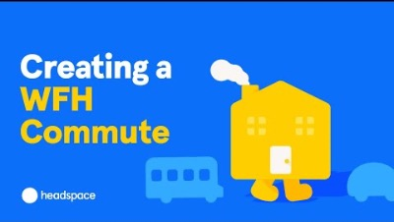
Notes:
How to transition in and out of work https://www.youtube.com/watch?v=dEkTWzAajlk

Slide 11

DISEASE AND OCCUPATIONAL STRESS
Physiological effects
Hypertension
Elevated serum cholesterol
Increased left ventricular mass
Increased catecholamines
Ex. dopamine, epinephrine
High plasma fibrinogen concentrations
Increased use of alcohol and drugs
Disease states
Coronary artery disease
Obesity
Diabetes
Hypertension
More heart attacks occur on Mondays than any other days
Notes:
Hypertensions is the thickening of the walls of a ventricle (lower chamber) of the heart- results from various stressors to the heart including hypertension
Catecholamines cause general physiological changes that prepare the body for physical activity
High plasma fibrinogen is associated with increased risk of total stroke

Slide 12



DISEASE AND OCCUPATIONAL STRESS
Psychological effects
Low self-esteem
Increased job tension
Low job satisfaction
Depression
Anxiety
Notes:
Lack of creativity, free will, choice will create these types of effects.

Slide 13

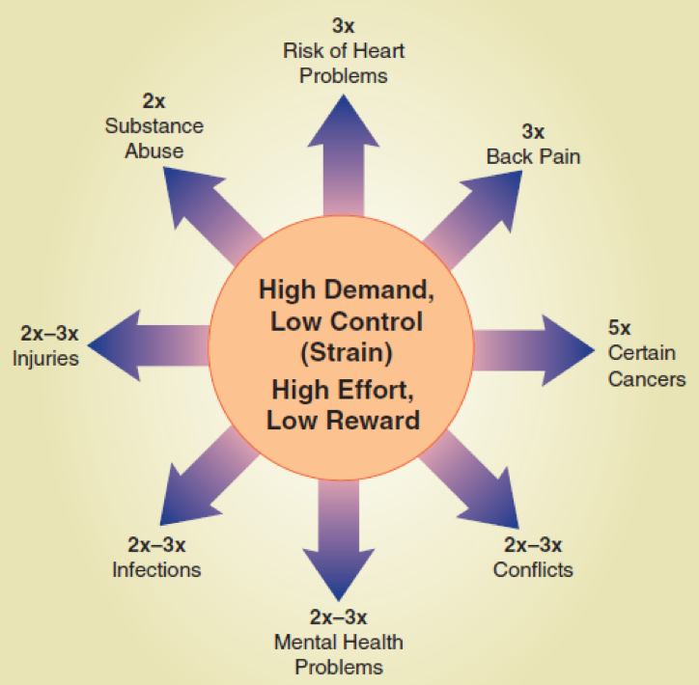

INCREASED RISK AS A RESULT OF STRESSFUL WORKPLACES
“Stressful workplaces” are defined as those with high demand and low control or high effort and low reward.
Notes:
Most stressful jobs are those that allow for very little decision making but has a huge workload that the worker has to get through very quickly.

Slide 14
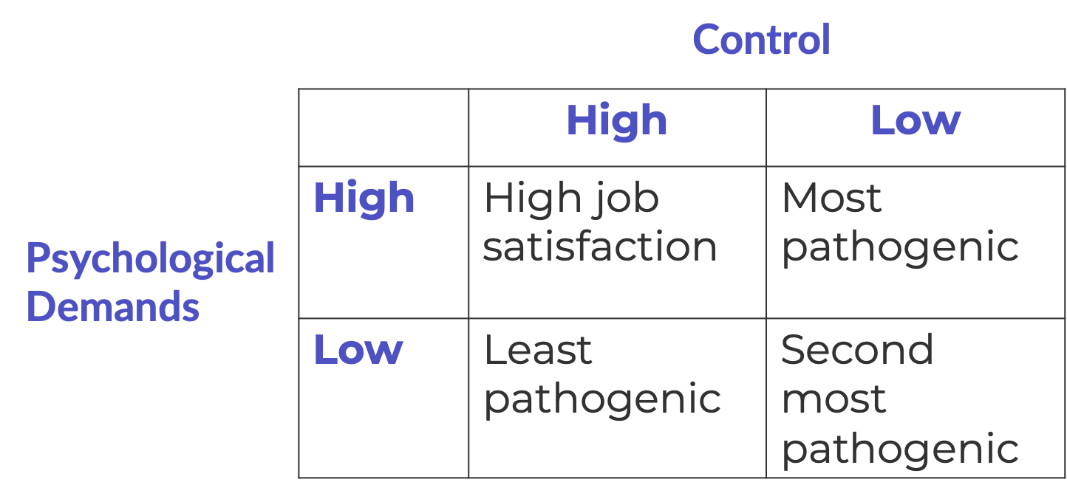
CONTROL/DEMANDS INTERACTION
Notes:
The amount of work doesn’t seem as critical to health as the control the worker has over the work rate or related work processes.
Those with lower levels of control of their demands, have increased rates of coronary heart disease and higher blood pressure.
People are happier when there is control and demands of the job.

Slide 15

Notes:
https://www.youtube.com/watch?v=lHgWwSGZ_-o

Slide 16

OCCUPATIONAL STRESSORS
Workers feel stress at work because of:
Lack of participation in decision-making process
Role problems:
Role overload
Role insufficiency
Role ambiguity
Role conflict
Job dissatisfaction
Motivational factors affect job satisfaction
Work environment
Notes:
Workers’ perceptions of the degree of their participation in the decision-making process, the degree to which they are consulted on the issues affecting the organization, their involvement in establishing rules of rules of behavior at work have proved to be related to job satisfaction, job-related feelings of threat, feelings of self-esteem.
A clear sense of your role in an organization and a sense:
Role overload: when job demands are so great that the worker feels an inability to cope- too much to do in too little time
Role insufficiency: when workers lack the training, education, skills, or experience to accomplish the job- poor fit between workers’ talents and organization’s expections
Role ambiguity: when aspects of the job and workplace are unclear, frustration and stress are likely to develop. Workers should know the criteria for career advancement and what’s expected of them
Role confliction: workers may be caught in a bind, ex. supervisors each expect something something.
Motivational factors: the degree of stimulating tasks involved, the amount of recognition for jobs done well, relationships with fellow workers, and the amount of encouragement to take on responsibility
Work environment: hazards create stress- dangerous tasks or work settings, toxic chemicals, high noise levels, dust, overcooling, unpleasant odors, and other stressful factors can lead to illness or disease.

Slide 17

THE WORKAHOLIC
Immersing oneself excessively in work at the expense of non-work activities
Identifying oneself more with the role of a worker rather than as an individual
Are you a person who happens to be a student, or are you a student who happens to be a person?
Notes:
Twenty Questions to Determine If You’re an Workaholic:
Are you more drawn to your work or activity than close relationships, rest, etc.?
Are there times when you are motivated and push through tasks when you don’t even want to and other times when you procrastinate and avoid them when you would prefer to get things done?
Do you take work with you to bed? On weekends? On vacation?
Are you more comfortable talking about your work than other topics?
Do you pull all-nighters?
Do you resent your work or the people at your workplace for imposing so many pressures on you?
Do you avoid intimacy with others and/or yourself?
Do you resist rest when tired and use stimulants to stay awake longer?
Do you take on extra work or volunteer commitments because you are concerned that things won't otherwise get done?
Do you regularly underestimate how long something will take and then rush to complete it?
Do you immerse yourself in activities to change how you feel or avoid grief, anxiety, and shame?
Do you get impatient with people who have other priorities besides work?
Are you afraid that if you don't work hard all the time, you will lose your job or be a failure?
Do you fear success, failure, criticism, burnout, financial insecurity, or not having enough time?
Do you try to multitask to get more done?
Do you get irritated when people ask you to stop doing what you're doing in order to do something else?
Have your long hours caused injury to your health or relationships?
Do you think about work or other tasks while driving, conversing, falling asleep, or sleeping?
Do you feel agitated when you are idle and/or hopeless that you'll ever find balance?
Do you feel like a slave to your email, texts, or other technology?
If you answered "yes" to three or more of these questions, you may be a workaholic. Relax. You are not alone. Many have found recovery through the W.A. fellowship.

Slide 18

COMBAT WORKAHOLISM
Focus on the work you most like doing, work that you wouldn’t mind “doing for free”
Use your time; don’t let it use you
Build friendships at work
Schedule open time into your work life
Learn to say no sometimes
Create a work environment that pleases you
Look for the positives in your job
Notes:
Try to minimize or delegate tasks that you don’t enjoy
Decide how much time you want to spend working and limit your time accordingly
Arrange to spend quality time with coworkers
Take breaks
Or say you’ll think about it and say no later
Decorate your space
Try to think about the things that you find most rewarding about your job

Slide 19

BURNOUT
Adverse stress reaction to work with psychological, psychophysiological, and behavioural components
Symptoms include:
Diminished sense of humour
Skipping rest and meals
Increased overtime/no vacation
Increased physical complaints
Social withdrawal
Changed job performance
Self-medication
Internal changes
Notes:
Burnout is an adverse stress reaction to work with psychological, and behavioural components. Symptoms include a diminished sense of humour, skipping rest and meals, increased overtime, no vacation, increased physical complaints, social withdrawal, changed job performance, self-medication and internal changes.
Diminished sense of humor- inability to laugh at daily on the job situations
Skipping rest and meals – no time for coffee or lunch breaks
Increased overtime/no vacation – can’t say no, indispensable
Increased physical complaints – fatigue, irritability, stomach upset
Social withdrawal – pulling away from coworkers, peers, family members
Changed job performance – decreased productivity, tardiness, use of sick days
Self-medication – increased use of alcohol, other drugs
Internal changes – depression, frustration, emotional exhaustion

Slide 20

COMBAT BURNOUT
Recognize the warning signs
Disconnect from your work devices
Evaluate your options
Discuss concerns with your supervisor to change expectations or create solutions
Find something that you feel is interesting to helps you gain more purpose and value
Take regular breaks during the workday
Create a support group
Reach out to co-workers, friends or loved ones, see if there's resources at work
Notes:
Disconnecting: If taking the entire evening or weekend off from handling work e-mails and calls isn’t realistic, try designating specific times to check in on emails and respond to voicemails. For example, on weekday evenings, you may check emails after dinner.

Slide 21

Notes:
https://www.youtube.com/watch?v=cFjK5WLpSHE

Slide 22

GENDER AND OCCUPATIONAL STRESS
Stressors that particularly affect women include:
Career blocks
Male-dominated climate
Gender stereotyping
Lack of role models
Notes:
We still see a number of stressors that are specific to women in the workplace. On average, women make 90 cents of every dollar men make in Canada. The gender pay gap is worse for those who face multiple barriers, including racialized women, Indigenous women, and women with disabilities.
Women are also statistically more likely to experience sexual harassment at work. They are also more likely to take on more of the domestic duties, such as raising children or cleaning the home, even if they are the primary breadwinners in the household. This is what has come to be known as "the double burden" or "the second shift." Housework contains the same risk for all of the same occupational stressors, but is often denigrated as easy or unimportant. This leads to increased stress placed on women, as they are expected to hold two jobs, one outside the household, and one inside the household, so their work never really ends. Other stressors include career blocks (also known as the glass ceiling), male-dominated climates, gender stereotyping, isolation, and/or a lack of role models.

Slide 23

WOMEN AND WORK OUTSIDE THE HOME
Females are more educated than males, yet it does not reflect in the workplace
Women are overwhelmingly employed in "traditional" roles:
Administrative assistants
Housekeeper or house cleaner
Social assistance, nursing
Cashiers
Child care
Notes:
Some ways to combat gender-specific stressors in the workplace include:
advocating for family friendly workplace policies such as flexible work schedules, paternity leave and health promotion programs
setting up shared responsibilities between partners in the home
speaking out against sexist work policies or employees
demanding equitable hiring policies, such as affirmative action, that place an equal amount of men and women in positions of power

Slide 24

Notes:
The Second Shift https://www.youtube.com/watch?v=mvzE6zYkEQY

Slide 25

FAMILY FRIENDLY WORKPLACE POLICIES
Job-sharing
Flexible work schedules
Parental leave
Remote work
Family medical leave
Child and elder care compensation
Temporary part-time
Flexible start and end times for workday
Counselling services
Notes:
A family friendly policy is a type of benefit that allows employees to partake in a flexible work environment so they can take care of children and loved ones.

Slide 26

RACIALIZED GROUPS AND OCCUPATIONAL STRESS
Emotional tax: The combination of feeling different at work because of gender, race and or ethnicity and the associated implications on thriving at work.
On guard: Consciously preparing to deal with potential bias or discrimination.
Workplace Racial Trauma: Microaggressions and macroaggressions that perpetuate racism and stereotypes and oppression
Notes:
Workplace Racial Trauma: micro and macroaggressions can happen over email; they can be nonverbal or verbal; they can manifest in the form of harassment, a lack of career advancement opportunities, such as promotions; and more
On Guard – When feeling on guard, racialized women feel they have to outwork and outperform their colleagues. Asian women (51 percent), Black women (58 percent), Latinas (56 percent) and multiracial women (52 percent) all report being highly on guard. Over 40 percent of Asian, Black, Latin and multiracial employees feel on guard because they anticipate racial/ethnic bias.
Statistics often bear that out, showing that to be paid equitably, enjoy the same opportunities for promotion and career advancement, or be seen as equally valid members on a team, that yes, people of color often do have to work twice as hard, or be twice as good at the things they take on.
Further reading: https://www.thestar.com/business/why-racialized-workers-are-more-stressed-than-ever/article_3104aaf1-0274-5552-9479-b36b8301a630.html

Slide 27


Slide 28

COPING WITH RACIALIZED STRESS
Work with a therapist
Find a therapist who understands systemic racism and oppression is an outlet that will make your experience easier until you’re comfortable moving on.
Find community
Close friendships and support groups help us get things off our chest, come up with new ways to handle situations and can inspire us to keep going.
Put yourself in the right environment
If you decide to look for a new job, research the company thoroughly
Practice self-care
Get an adequate among of sleep, utilize destressors
Notes:
Put yourself in the right environment
If you decide to look for a new job:
Take a good look at the senior leadership and executive teams. What are their ethnicities, genders and nationalities? Even places of education and former places of employment can give away a fixed mindset and an environment that doesn’t welcome diversity.
What are the company’s current diversity initiatives, and what are similar companies doing to ensure diversity?
Now ask yourself, are they really going above and beyond or does it seem like a checkbox exercise?
Talk to people to find out about the employee experience.
Employee experience is everything to do with attracting, hiring, on-boarding, developing and an employee leaving a company. Ask questions to find out whether the employee experience is rooted in respect.

Slide 29

OCCUPATIONAL STRESS IN SUMMARY
Don’t take work home
Disconnect from your work devices
Take breaks; don’t eat lunch at your desk
Separate your self-worth from the task
Schedule regular exercise
Separate your self worth from the task
Notes:
Discuss your feelings about occupational stress with someone close to you, if they are available.
If you fail a task, it does not mean you are a failure
Distinguish between need and desire- do you need to get this done or do you wish you could get it done?
Identify situations and employ the appropriate style of coping
Problem based coping- use of activities to get a task done
Emotion based coping- use of activities to feel better about the task

Slide 30
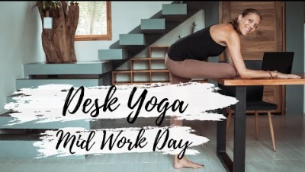
MINDFUL MOMENT
Notes:
https://www.youtube.com/watch?v=UBvkJM9ULZA

